Slide 1
Identifying regions of faces
By Aaron, Gytis, Seamus and James

Slide 2
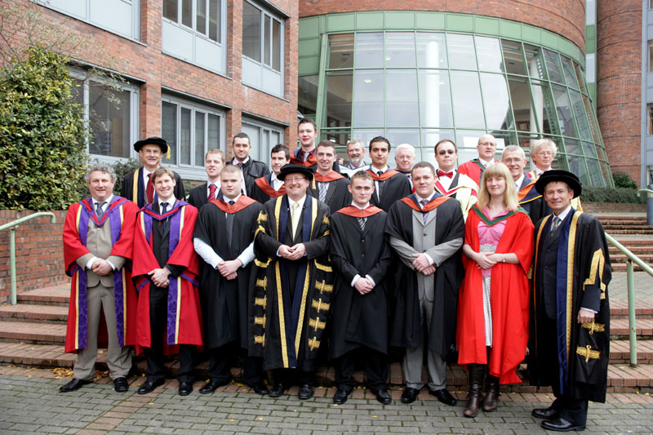
Our Project
To detect the regions of faces in this image

Slide 3
Research
HOG – Histogram of oriented gradients
Haar-Cascades Algorithm for face detection

Slide 4
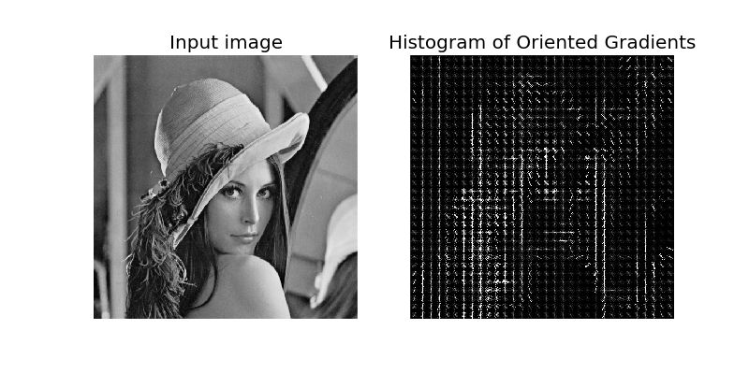
HOG
Needed to be pre-compiled
Only worked on an out-dated version of Visual Studio
Too complex for the task at hand
Would not work on Python 2.7 or Open CV versions later than 3
(Sharky93.github.io, 2017)

Slide 5
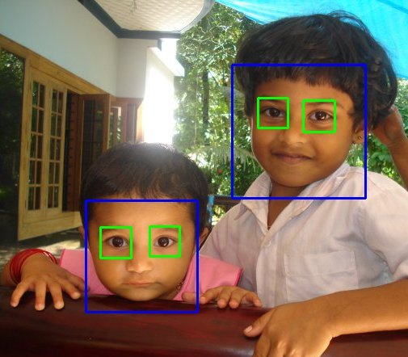
Haar-cascades
Readily available
Low percentage of error
Machine Learning algorithm
Part of OpenCV
(Docs.opencv.org, 2017)

Slide 6
Implementation
In Python using OpenCV
Convert to Greyscale
Enlarge image to help cascade
Cascade for faces
10% skin check
Draw boxes around regions
Reduce to original size
Show image

Slide 7
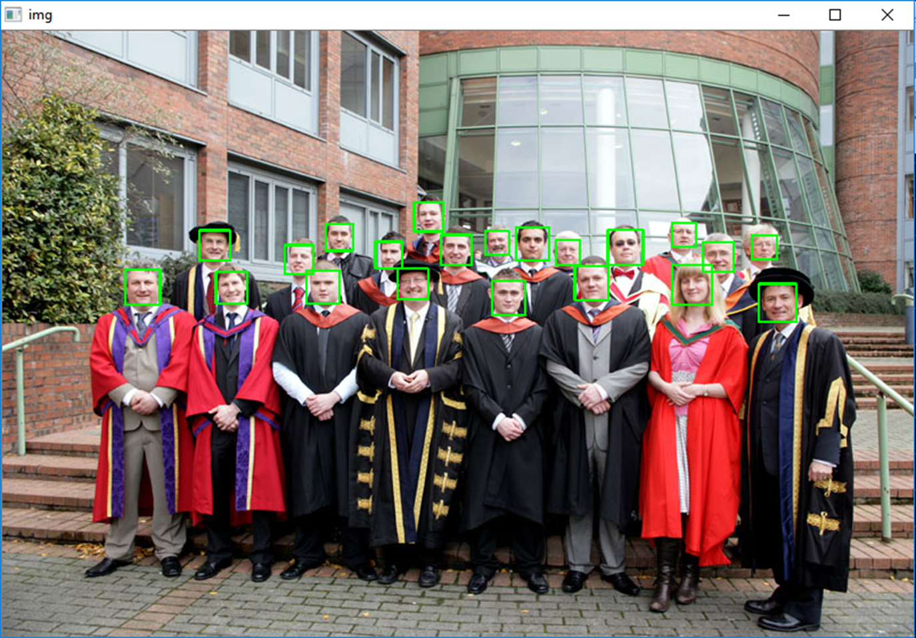

Slide 8

Results
Tested on Different Images
Reduced amount of false positives
Final Product First iteration(no skin detection)

Slide 9
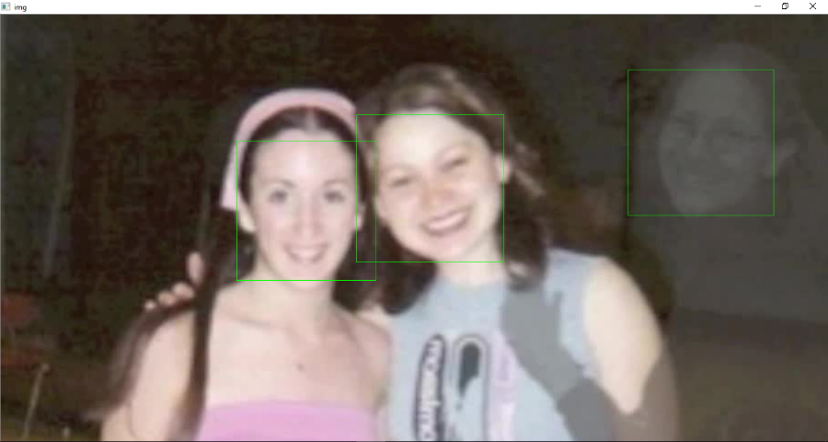
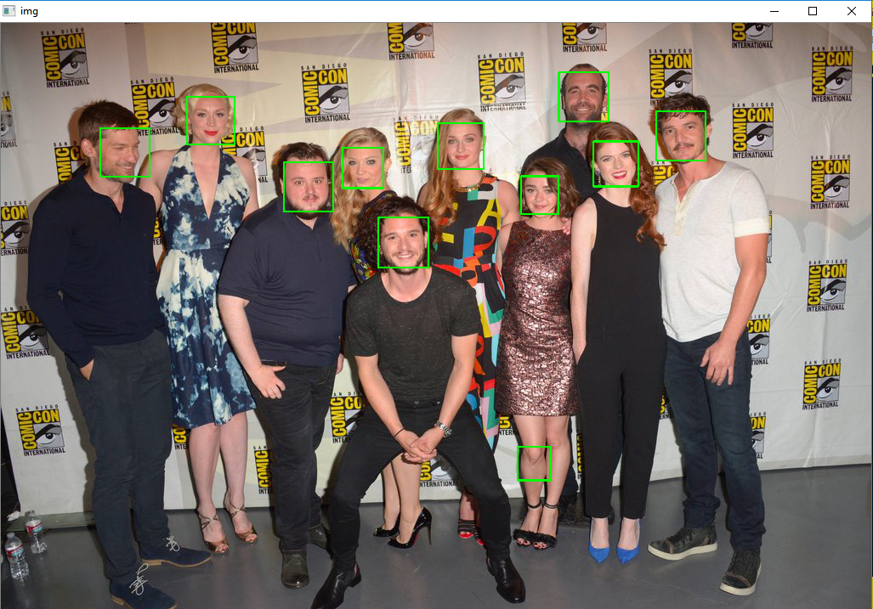
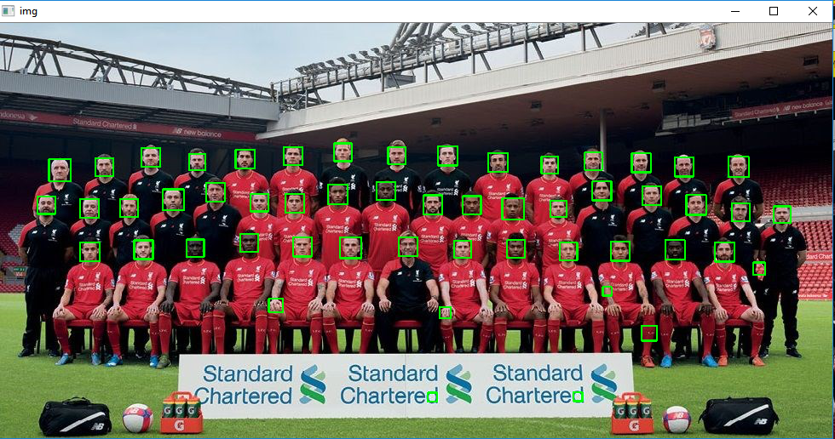
Reflection and Analysis
Team worked well
Algorithm is solid, fails at points
Task completed adequately
Would like to expand to facial recognition

Slide 10
Thank y’all
References:
Docs.opencv.org. (2017). OpenCV: Face Detection using Haar Cascades. [online] Available at: https://docs.opencv.org/3.3.0/d7/d8b/tutorial_py_face_detection.html [Accessed 24 Nov. 2017].
Sharky93.github.io. (2017). Histogram of Oriented Gradients — skimage v0.11dev docs. [online] Available at: http://sharky93.github.io/docs/gallery/auto_examples/plot_hog.html [Accessed 24 Nov. 2017].

